Slide 1
TANK SHOOTING GAME
BY HAMNA IFTIKHAR

Slide 2

INTRODUCTION
WHY SELECTION OF AI
IMPORTANCE OF AI

Slide 3
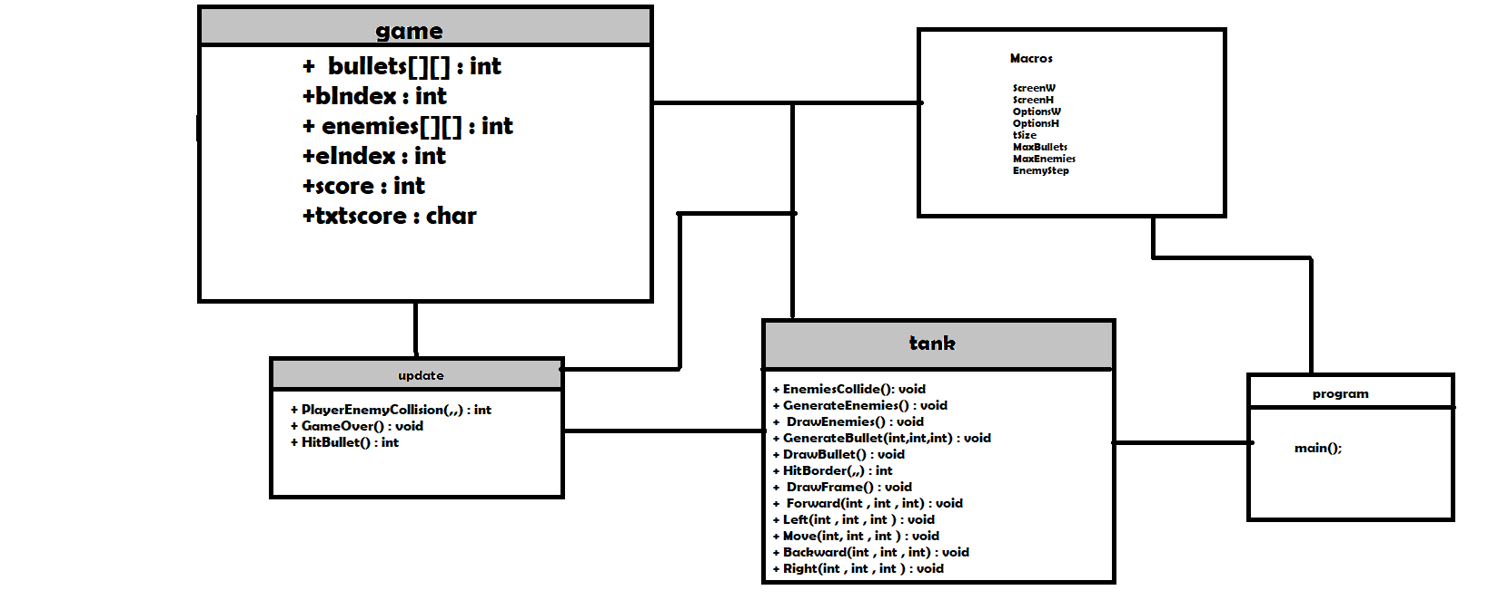
CLASS DIAGRAM

